Slide 1
Lecture 3- Image and Graphics
Basic Image Concept:
Representation and Format
Image Processing Fundamentals
Synthesis
Analysis and
Transmission
Image Enhancement
Spatial Filtering - Enhancement by Point Processing
Color image processing

Slide 2
Image Definition
Image is the Spatial representation of
an object
a 2-D or 3-D scene or
another image
Images may be Real or Virtual
Can be abstractly thought of as continuous function defining usually a rectangular region of plane
recorded image- photographic, analog video signal or in digital format
computer vision- video image, digital image or picture
computer graphics- digital image
multimedia- deals about all above formats
But, to use digital computer, digital image format is most important

Slide 3
Basic Concept
Representation of light intensity at each point over a planar region
Digital Image is represented by a matrix or numeric values representing the intensity of each point
Picture elements or pixels are the points at which image is sampled and intensity is found by averaging around the small neighborhood of pixel
If only two intensity values – 0 and 1 are possible, the image is called binary-valued
Intensity
If n bit integers are used to store each pixel’s intensity value, 2n different intensities (colors) are possible numbered from 0 to 2n-1

Slide 4
Basic Concept Contd…
Image resolution
depends on the distance between pixel grids and imaging system also (persistence and spot profile)
Image file-size
depends on total number of pixels and no. of bits per pixel (quantization)
Image file-size = W*L*n bits where
W = width (pixels)
L = length or height (pixels)
n = number of bits per pixel

Slide 5
Basic Concept Contd…
Image Formats
Captured Image format:
Image format that comes out of an image frame grabber
specified by mainly two parameters:
Spatial Resolution (pixel × pixel)
Color encoding (bits per pixel)

Slide 6
Basic Concept Contd…
Stored Image Format
storing an image means storing a two-dimensional array of values (data associated with the image)
for bitmap-
value is binary digit
for color image-
value may be collection of RGB components
indices to tables of RGB intensities
single index to a table of color triples
any other index to data structure that can represent a color
image consists of RGB channels which gives info. about the pixels of image
finally- width, height, depth, creators’ name are also incorporated before saving the image file
Examples- RIFF (Resource Interchange File Format), BRIM, GIF, JPEG etc.

Slide 7
Image Processing Fundamentals
Computer Graphics concern the pictorial synthesis of real or imaginary objects from their computer-based models
But Image Processing treats in converse process- analysis of scenes or reconstruction of models from pictures of 2D and 3D objects
Three main parts
Image Synthesis
Image Analysis
Image Transmission

Slide 8
Image Synthesis
An integral part of all computer user interfaces and is indispensable for visualizing 2D, 3D objects
Areas as diverse as education, science, engineering, medicine, and entertainment all rely on graphics
Some representative samples:
User Interface
Point-and-click facility
Menu-driven
Office automation and electronic publishing
Desktop publishing
Electronic publishing
Hypermedia Systems
Simulation and Animation for Scientific Visualization and Entertainment
Simulation of real time systems
Visualization of time-varying behavior of systems
Abstract representation of complex mathematical expressions
Models for fluid flow, chemical reaction etc.
Cartoons
Flying logos and more exciting visual for movies

Slide 9
Dynamics in Graphics
Graphics may be static or dynamic
Dynamics may be
Motion dynamics: changes occur in the position of the objects
Update dynamics: changes occur in shape, size and/or structure of an object

Slide 10
Image Analysis
Concerned with techniques for extracting descriptions from images for higher-level scene analysis methods
Image processing include
Image enhancement (brightness, contrast etc.)
Pattern detection and recognition (e.g. OCR, handwriting recognition, finger prints)
Scene analysis and computer vision (e.g. robot sensing the size, shape, position, color etc. of objects)

Slide 11
Image Recognition
Spatial configuration of pixel values should be analyzed
Kind of object, background, imaging sensor, viewpoint of sensor determine the ease of recognition
Formatting
Capturing an image from a camera and bringing it into a digital form i.e. the digital representation of an image in the form of pixels
Conditioning
Estimates the informative pattern on the basis of observed image
Suppresses noise
Background normalization
Context-independent
Labeling
Edge detection (where the intensity level changes abruptly)
Thresholding (which edge should be accepted and which should not)
Corner finding

Slide 12
Image Recognition Contd…
Grouping
Grouping the pixels actively participating in the spatial information (edge or corner etc.)
Line-fitting
Extracting
Finding other info. such as centroid, area, orientation etc
Matching
Determining the interpretation of some related set of image events
Associating the events with some given 3D object or 2D shape
Example- inspecting some values by matching image with a book, a chair or an alphabet

Slide 13
Image Transmission
Image Transmission
Transmission of digital images through any network (not only computer network)
Bursty data transport
Reliability
Time-dependence is not critical (asynchronous data transfer can be used)
Methods such as JPEG and MPEG can be used to compress raw image data before transmission
Images can also be represented by image primitives, attributes and other control info such as in GIF

Slide 14
Dithering
Dithering is the attempt by a computer program to approximate a color from a mixture of other colors when the required color is not available.
Human eye approximates the intensity of a group of pixels as a single point if viewed from distance
Group of pixels can be taken as group to make more no. of intensities available
2x2 pattern area can give five intensity levels for bi-valued pixel representation (1 bit per pixel)

Slide 15
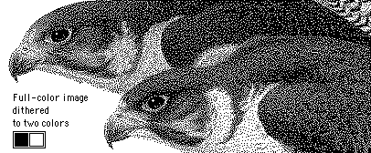
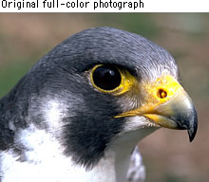

Slide 16
Dithering Contd…
For 3-bit per pixel representation (1 bit for R, G and B each) 2x2 pattern area can provide 5x5x5=125 different intensities
R- 2x2 = 5 intensity level
G- 2x2 = 5 intensity level
B- 2x2 = 5 intensity level
5 x 5 x 5 = 125 different intensities

Slide 17
IMAGE ENHANCEMENT TECHNIQUES
widely used in computer graphics.
sub areas of image processing.
The principle objectives - to process an image so that the result is more suitable than the original image for a specific application .
Improvement of pictorial information for human interpretation
Processing of image data for storage, transmission and representation for autonomous machine perception
Some argument about where image processing ends and fields such as image analysis and computer vision start

Slide 18
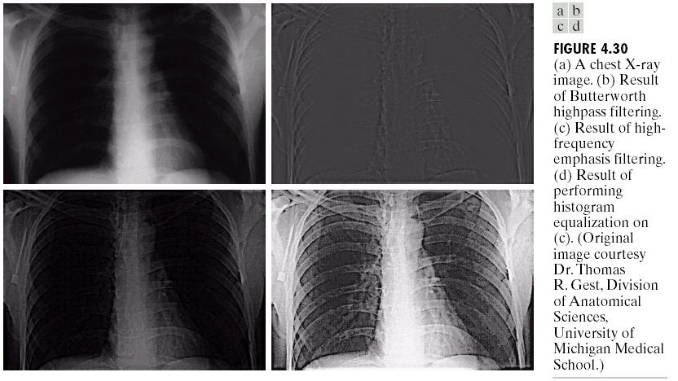
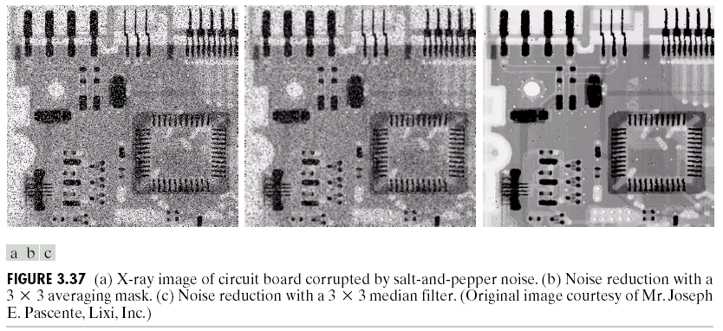
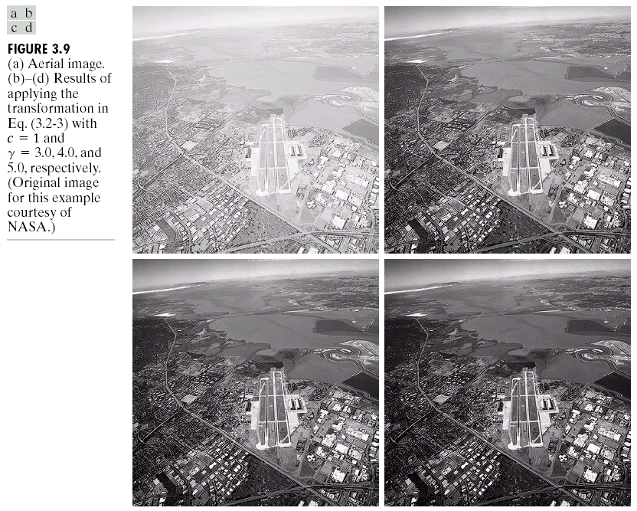
Examples: Image Enhancement
One of the most common uses of DIP techniques: improve quality, remove noise etc

Slide 19
METHODS FOR IMAGE ENHANCEMENT
1.Spatial domain methods .
2 Frequency domain methods.

Slide 20
SPATIAL DOMAIN METHODS
refers to the aggregate of pixels composing an image.
procedures that operate directly on these pixels.
denoted by the expression ,
g(x,y)= T[f(x,y)]

Slide 21
POINT PROCESSING
It is the process of contrast enhancement.
It is the process to produce an image of higher contrast than the original by darkening a particular level.
Enhancement at any point in an image depends only on the gray level at that point techniques in this category are often referred to as point processing.

Slide 22
Median and Max/Min filtering
Median filtering is a powerful smoothing technique that does not blur the edges significantly .
Max/min filtering is used where the max or min value of the neighborhood gray levels replaces the candidate pixel .
Shrinking and expansion are useful operations especially in two tone images.

Slide 23
IMAGE SUBTRACTION
The difference between two images f(x,y) and h(x,y) are expressed as,
G(x,y)= f(x,y) – h(x,y)
obtained by computing the difference between all pairs of corresponding pixels from f and h.
The key usefulness of subtraction is the enhancement of difference between images.
One of the most commercially successful and beneficial uses - in the area of medical imaging called mask mode radiography .

Slide 24
FREQUENCY DOMAIN METHODS
We compute the Fourier transform of the image to be enhanced, multiply the result by a filter and take the inverse transform to produce the enhanced image.

Slide 25
IMAGE SMOOTHING
The aim of image smoothing is to diminish the effects of camera noise, spurious pixel values, missing pixel values etc.
Two methods used for image smoothing.
neighborhood averaging and
edge preserving smoothing.

Slide 26
Neighbourhood Averaging
Each point in the smoothed image,F(X,Y) is obtained from the average pixel value in a neighbourhood of (x,y) in the input image.
For example, if we use a 3*3 neighbourhood around each pixel we would use the mask .Each pixel value is multiplied by 1/9, summed, and then the result placed in the output image

Slide 27
Edge preserving smoothing
An alternative approach is to use median filtering instead of neighborhood averaging.
Here we set the grey level to be the median of the pixel values in the neighborhood of that pixel.
The outcome of median filtering is that pixels with outlying values are forced to become more like their neighbors, but at the same time edges are preserved ,so this also known as edge preserving smoothing.

Slide 28
Image sharpening
The main aim in image sharpening is to highlight fine detail in the image, or to enhance detail that has been blurred

Slide 29
Conclusion
The aim of image enhancement is to improve the information in images for human viewers, or to provide `better' input for other automated image processing techniques
There is no general theory for determining what is `good' image enhancement when it comes to human perception. If it looks good, it is good!

